Slide 1
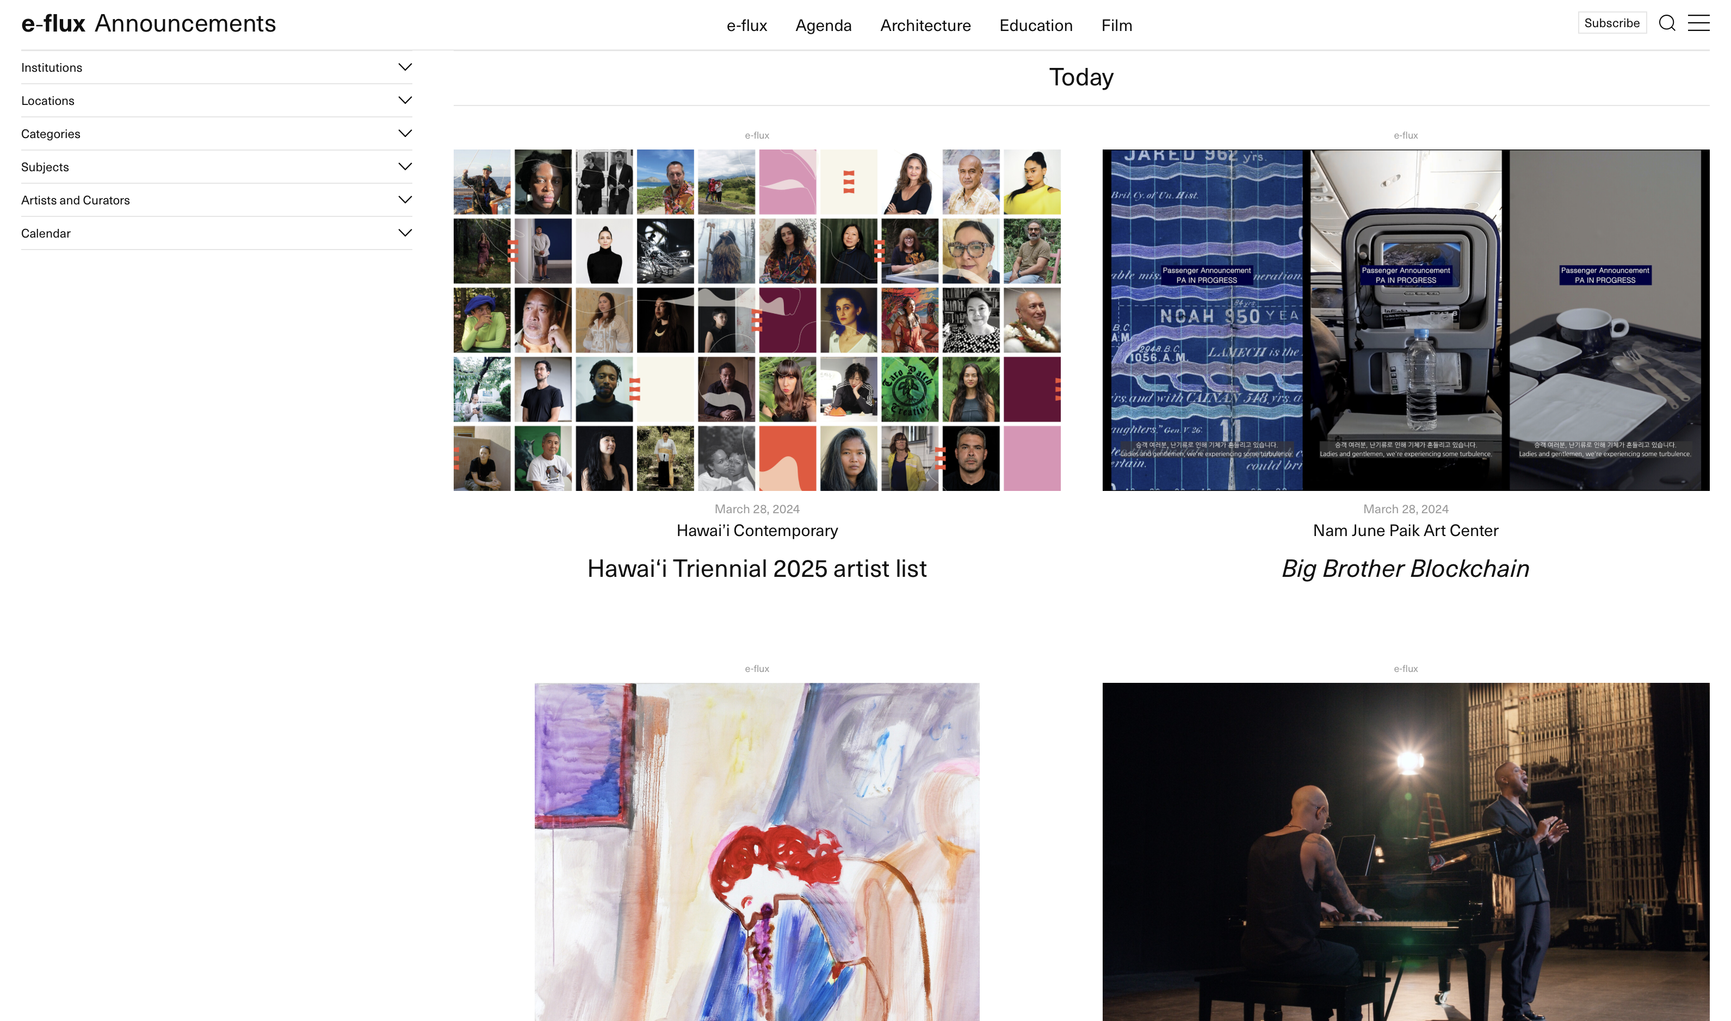
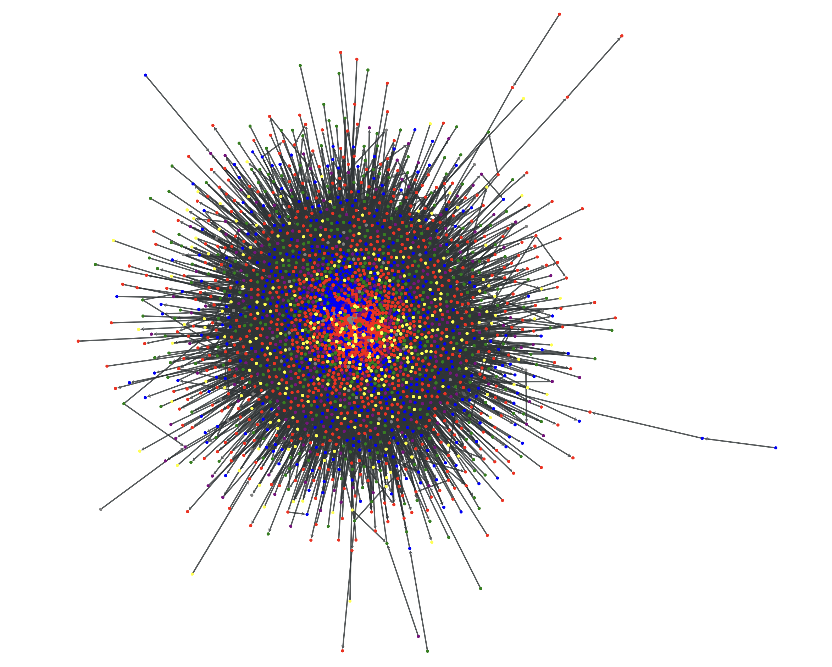
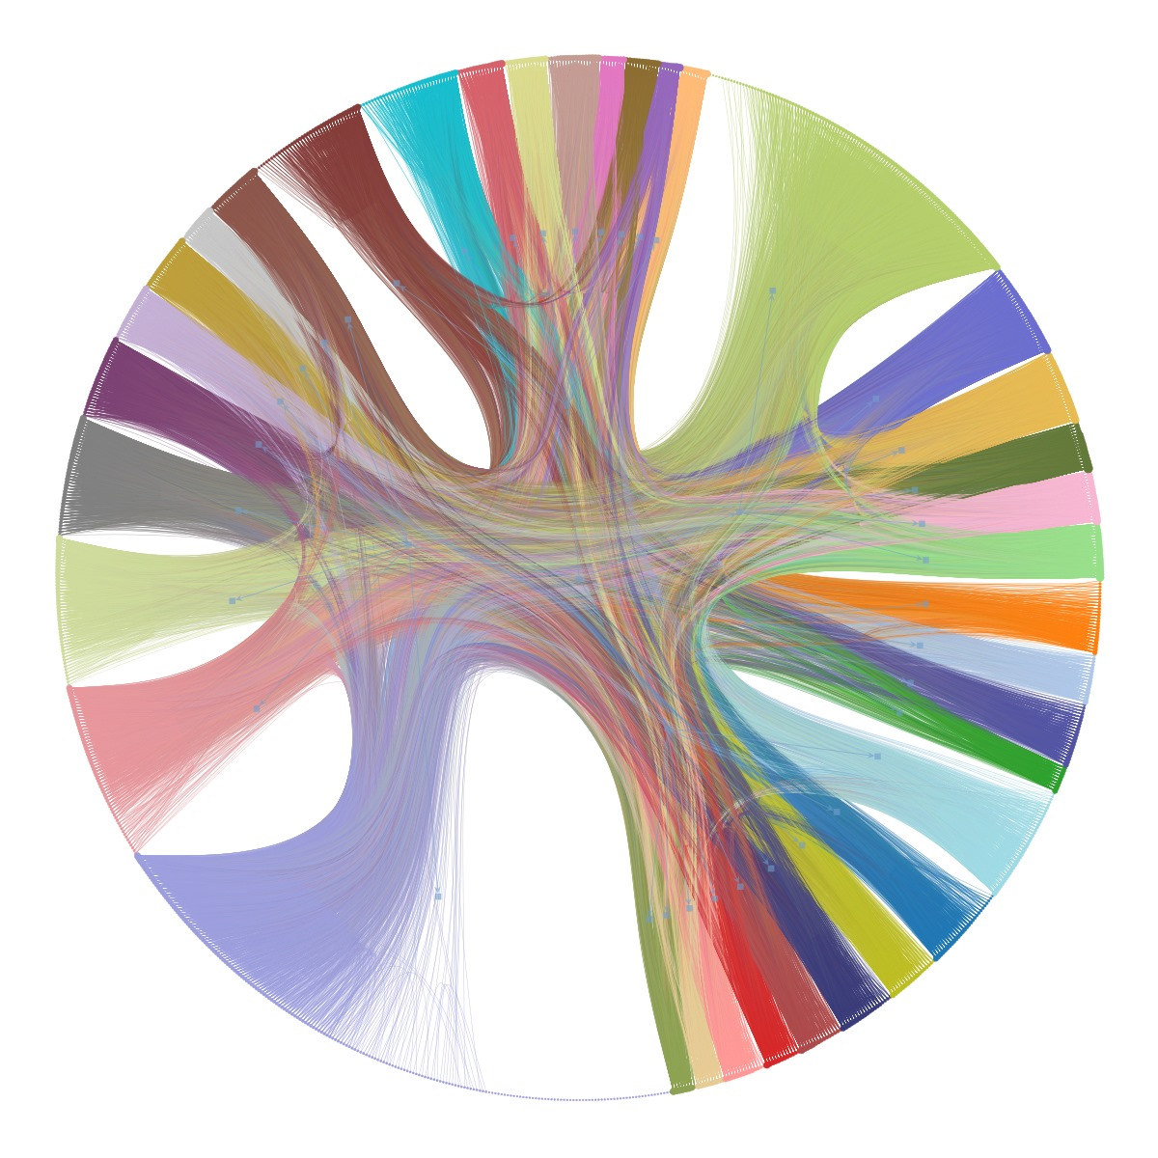
scrapping
e-flux:
contemporary art
events over the
last twenty years
Mihaly Hanics, Artem Timonov, Sebastian Štros | Data Collection Methods | MSc SDS | CEU 2023–24

Slide 2

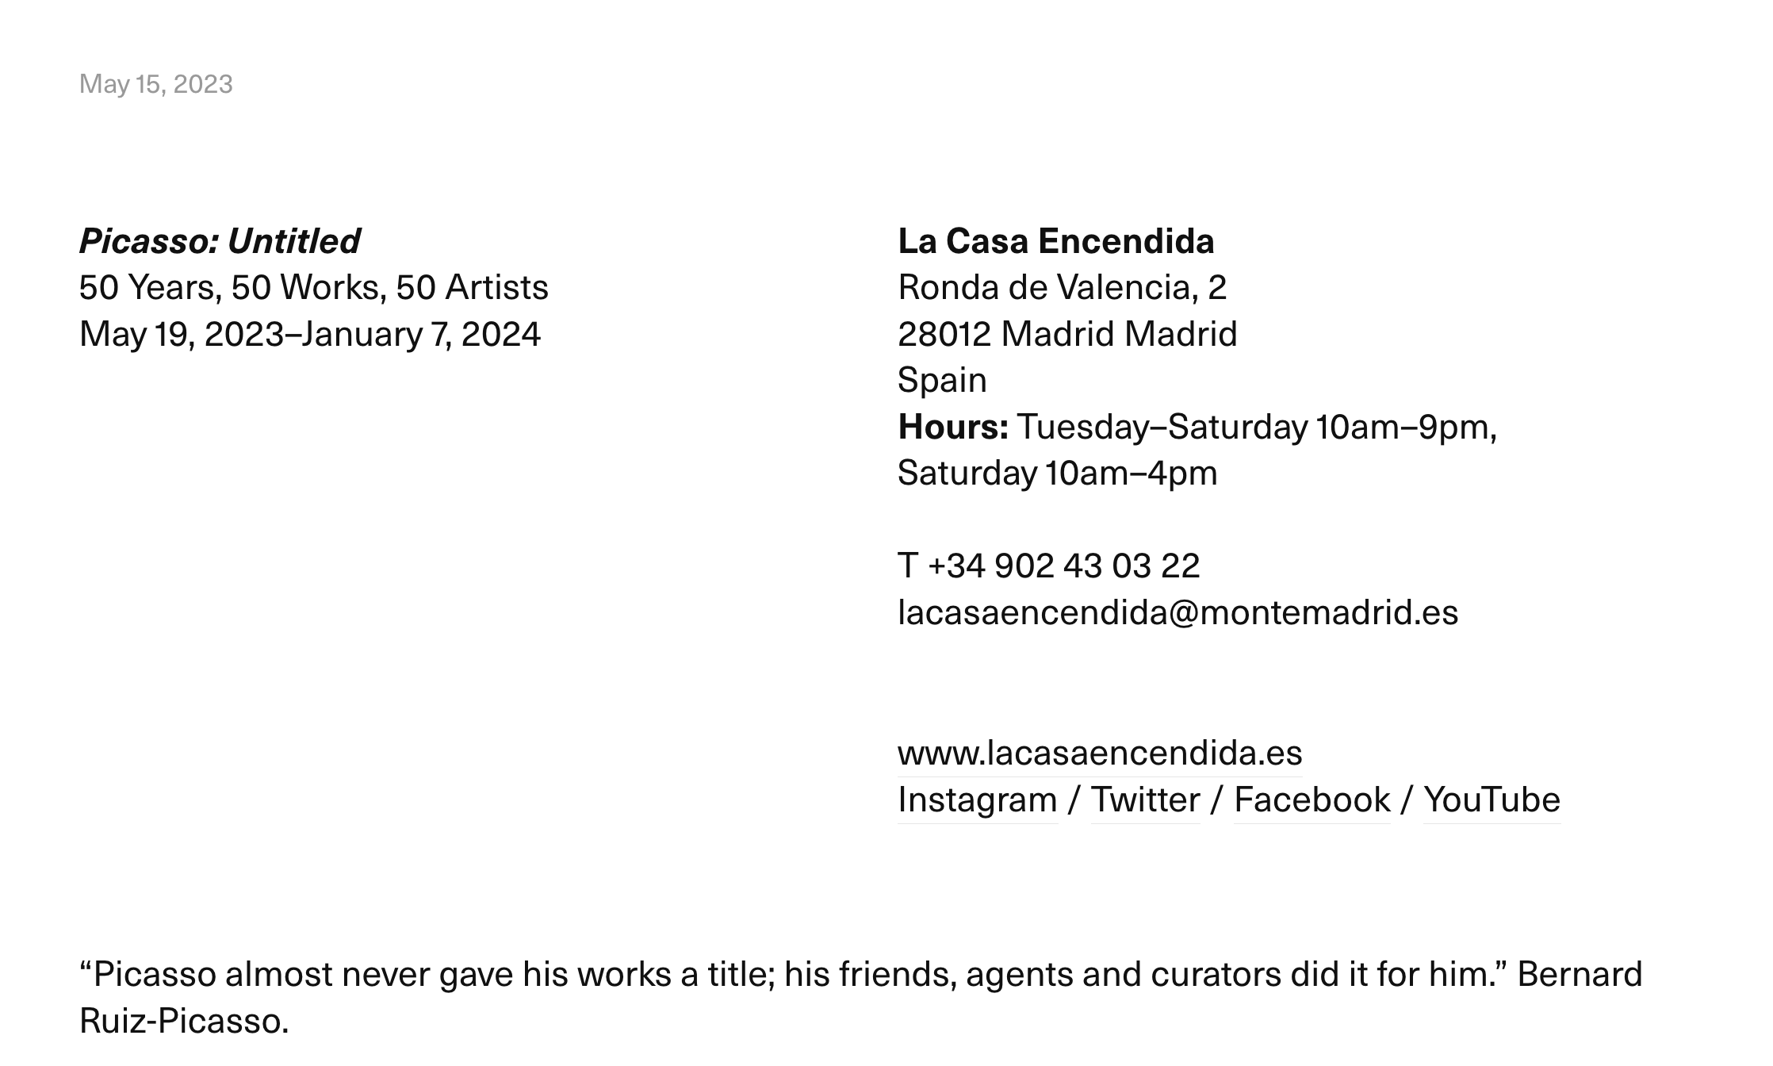
e-flux data:
overview
e-flux data:

Slide 3
e-flux data:
overview
e-flux data:

Slide 4
e-flux data:
structure
e-flux data:
e-flux announcement
date
artists
institution
type

Slide 5
e-flux announcement
date
artists
institution
type

Slide 6
approach
e-flux data:
artists
e-flux announcement
date
institution
type

Slide 7
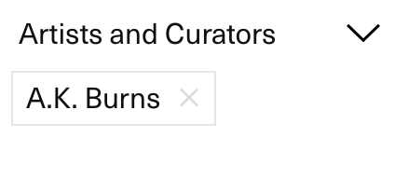

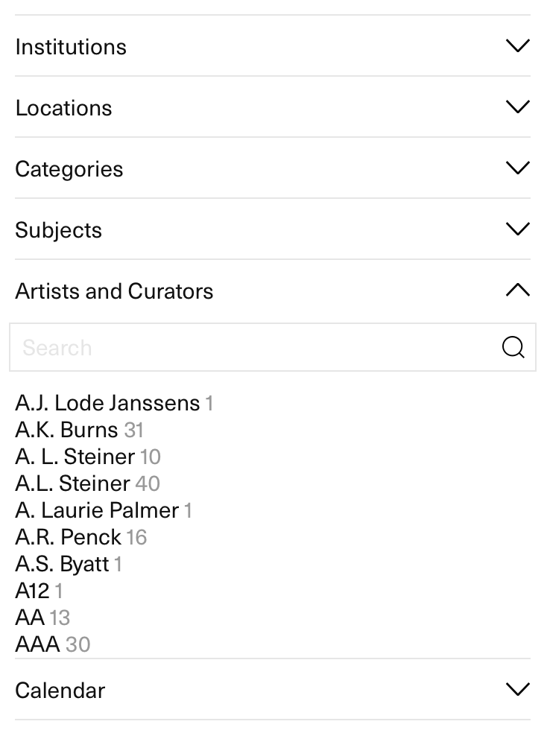
approach
e-flux data:
artist
e-flux announcements
dates
institutions
types

Slide 8
approach
e-flux data:
artist
e-flux announcements
dates
institutions
types

Slide 9
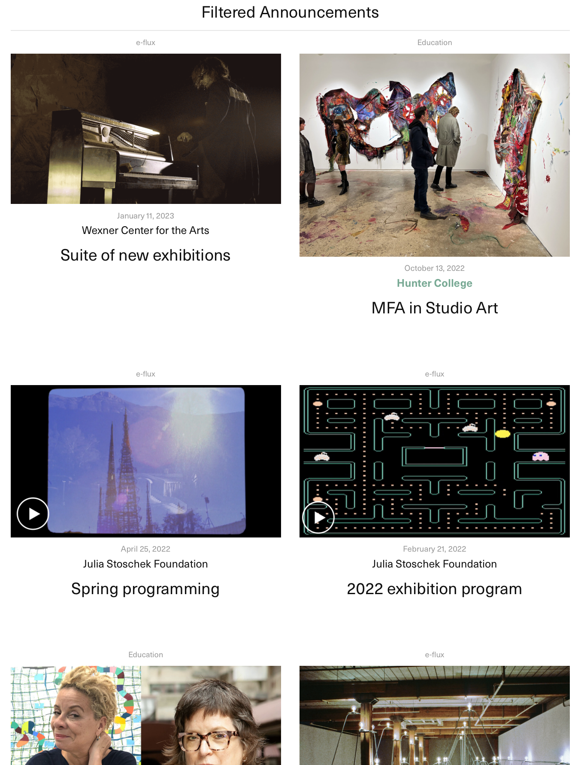
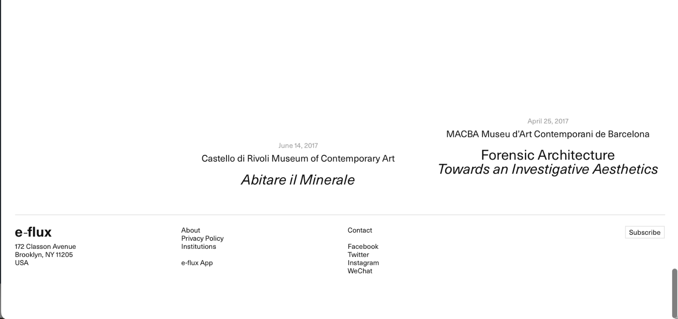
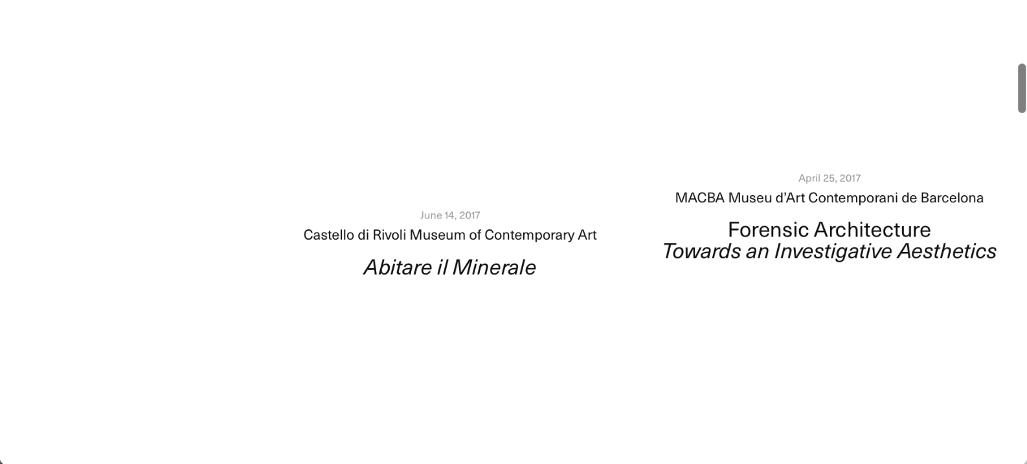
request
e-flux data:
artist
e-flux announcements
dates
institutions
types

Slide 10
artist
e-flux announcements
dates
institutions
types

Slide 11
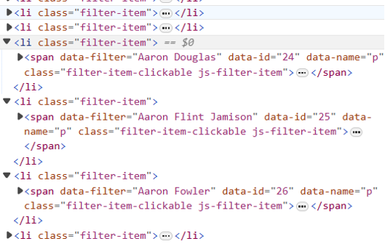
scroll
e-flux data:
artist
e-flux announcements
dates
institutions
types

Slide 12
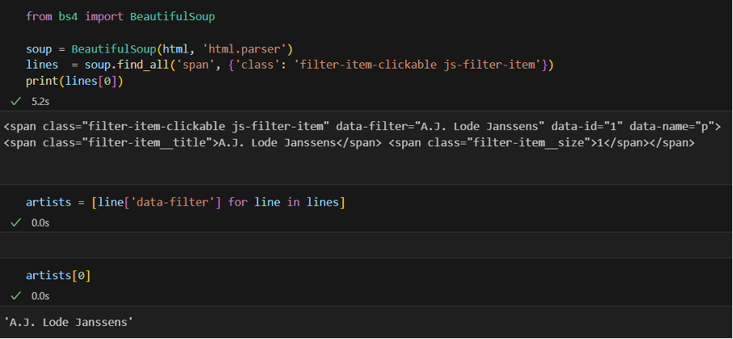
roadmap
e-flux data:
raw data
artists
parsing
artists
filtering
artists
collecting
announcements, dates, institutions
artist
raw data: 22,000 artist list
e-flux announcements
network
dates
institutions
networks
types

Slide 13
e-flux data:
raw data
artists
roadmap
parsing
artists
filtering
artists
collecting
announcements, dates, institutions
artist
e-flux announcements
network
dates
institutions
networks
types

Slide 14
raw data
artists
parsing
artists
filtering
artists
collecting
announcements, dates, institutions
network
networks

Slide 15
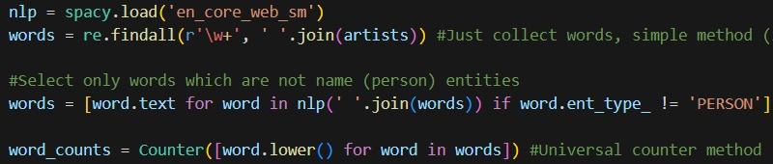
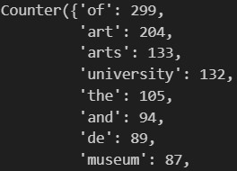
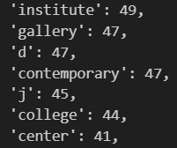
roadmap
e-flux data:
raw data
artists
parsing
artists
filtering
artists
collecting
announcements, dates, institutions
artist
e-flux announcements
network
dates
institutions
networks
types

Slide 16
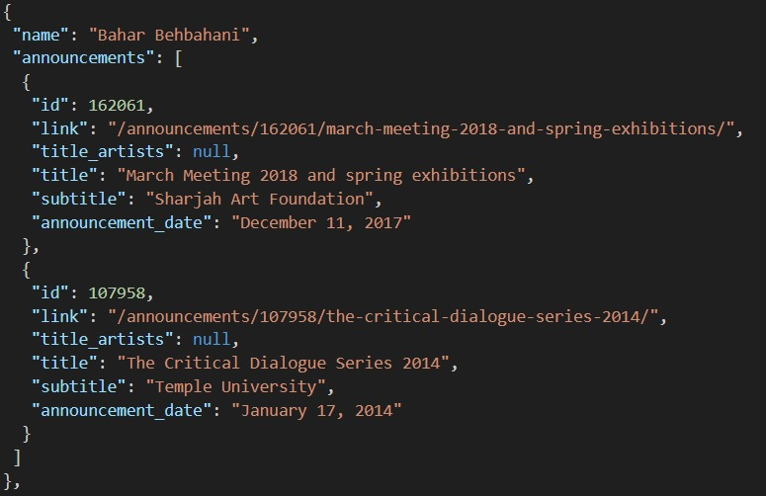
roadmap
e-flux data:
raw data
artists
parsing
artists
filtering
artists
collecting
announcements, dates, institutions
artist
filtered part:
1,000 / 22,000 artists
e-flux announcements
network
dates
institutions
networks
types

Slide 17
roadmap
e-flux data:
raw data
artists
parsing
artists
filtering
artists
collecting
announcements, dates, institutions
artist
e-flux announcements
network
dates
institutions
networks
types

Slide 18
roadmap
e-flux data:
raw data
artists
parsing
artists
filtering
artists
collecting
announcements, dates, institutions
artist
e-flux announcements
network
dates
institutions
networks
types

Slide 19
community
detection
e-flux data:
47 communities
artist
e-flux announcements
network
dates
institutions
networks
types

Slide 20
alternative
e-flux data:
artist
e-flux announcements
dates
institutions
types

Slide 21
alternative
e-flux data:
artists
e-flux announcement
date
institution
types

Slide 22
alternative
e-flux data:
artists
e-flux announcement
date
institution
type

Slide 23
alternative
e-flux data:
institution
type
date
artist trajectories

Slide 24
alternative
e-flux data:
institution
type
date
artist trajectories

Slide 25
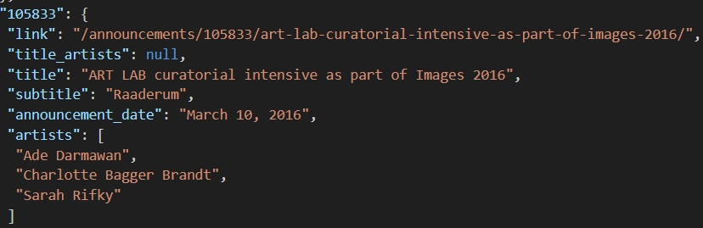
e-flux data:
institution
type
date
institution
trajectory
network
artist trajectories
2,700 vertices
58,000 edges

Slide 26
scrapping
e-flux:
contemporary art
events over the
last twenty years
Mihaly Hanics, Artem Timonov, Sebastian Štros | Data Collection Methods | MSc SDS | CEU 2023–24

